Slide 1
Course : MCA Sem II
Subject : Python Programming
( Subject Code: IT21 )

Slide 2
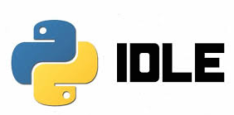

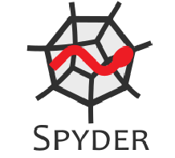
Python Editors
Python Editors | Description | Logo
IDLE | IDLE (Integratedand Learning Environment) is a popular Integrated Development Environment written in Python and it has been integrated with the default language. Mainly used by beginner's level developers who want to practice Python development
PyCharm | LogoPyCharmPyCharm is one of the widely used Python IDE which was created by Jet Brains. With PyCharm, the developers can write a neat and maintainable code. It helps to be more productive and gives smart assistance to the developers. It takes care of the routine tasks by saving time and thereby increasing profit accordingly
Spyder | It was mainly developed for scientists and engineers to provide a powerful scientific environment for Python. It offers an advanced level of edit, debug, and data exploration features. It is very extensible and has a good plugin system and API

Slide 3
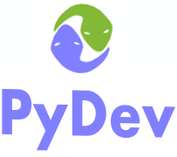

Python Editors
Python Editors | Description | Logo
PyDev | PyDev is an outside plugin for Eclipse. It is basically an IDE that is used for Python development. It is linear in size. It mainly focuses on the refactoring of python code, debugging in the graphical pattern, analysis of code etc. It is a strong Python interpreter
Jupyter Notebook | The Jupyter Notebook is a browser-based graphical interface to the IPython shell. Allows us to create and share documents that contain live code, equations, visualizations and narrative text.

Slide 4
Limitations of Python
Python is an interpreter based language. Therefore, it is a bit slower than compiler based languages.
Python is a high level language like C/C++/Java. It also uses many layers to communicate with the operating system and the computer hardware.
Graphics intensive applications such as games make the program to run slower.
Due to the flexibility of the data types, Python's memory consumption is also high.

Slide 5
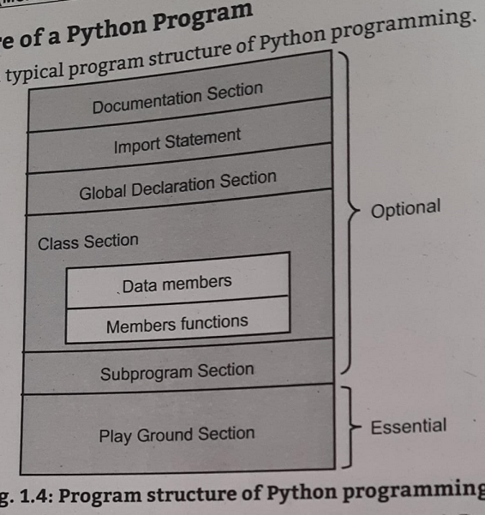
Python Program Stricture

Slide 6
Running Python on IDLE
1.1.6 Running Python Script Python has two basic modes, namely normal and interactive.
The normal script mode is the mode where the scripted and finished py files are run in the Python interpreter.
The interactive mode is a command line shell which gives immediate feedback for each statement, while running previously fed statements in active memory. As new lines are fed into the interpreter, the fed program is evaluated both in part and in whole.
Interactive Mode: Interactive mode is used for quickly and conveniently running single line or blocks of code. Here's an example using the Python shell that comes with a basic Python installation. The ">>>" indicates that the shell is ready to accept interactive commands. For example, if we want to print the statement "Interactive Mode", simply type the appropriate code and hit enter.
Script Mode: In the standard Python shell, we can go to "File"→ "New File" (or just hit Ctrl + N) to pull up a blank script to write the code. Then save the script with a ".py" extension. We can save it anywhere we want for now. though we may want to make a folder somewhere to store the code as we test Python output. To run the script, either select "Run"→ "Run Module" or press F5

Slide 7
Roll of Python in Data Science
Artificial Intelligence (AI) is an area of computer science that gives priority t creating intelligent machines that can work like human-beings such as speech recognition, visual perception, translation, and even decision making. NumPy for scientific computation, PyBrain for Python Machine Language, SciPy for advanced Computing, are the libraries to make Python is the suitable language for AL. IDE (Integrated Development Environment) supports to avoid struggles of developers with the use of many algorithms. Python has various library packages to develop and decode the Al project and DataScience. Some of the specialized packages as follows:
NumPy: NumPy stands for Numerical Python. NumPy is a Python library thatprovides mathematical functions to handle large dimension arrays. It is used as acontainer for generic data comprising of an N-Dimensional Array Object,Integrating tools for C/C++ Codes, Random Number Capacity, and otherfunctions. The library provides vectorization of mathematical operations on theNumpy array type, which enhances performance and speeds up the execution

Slide 8
Roll of Python in Data Science
2. Pandas: It gives easy-to-use data structures and analytics tools for Python and it is an open-source library. Pandas is one of the most popular Python library for data manipulation and analysis. Pandas provide useful functions to manipulate large amount of structured data. Pandas provide the easiest method to perform analysis. It provides large data structures and manipulating numerical tables and time series data. Pandas is a perfect tool for data wrangling. Pandas is designed for quick and easy data manipulation, aggregation, and visualization. There are two data structures in Pandas: Series: It handles and stores data in one-dimensional data.
DataFrame: It handles and stores two-dimensional data.o

Slide 9
Roll of Python in Data Science
3. Matplotlib: It is a 2D plotting library to create publication-quality images. Matplotlib is another useful Python library for Data Visualization. Matplotlib allows making quick line graphs, pie charts, histograms, and other professional grade figures. Matplotlib has interactive features like zooming and planning and saving the Graph in graphics format.
4. SciPy: Scipy is another popular Python library for data science and scientific computing. Scipy provides great functionality to scientific mathematics and computing programming. SciPy contains sub-modules for optimization, linear algebra, integration, interpolation, special functions, FFT, signal and image. processing, ODE solvers, Statmodel and other tasks common in science and engineering.
5. AIMA: "Artificial Intelligence - A Modern Approach" by Russel and Norvig used for implementing algorithms for general AI.
6. pyDatalog: It is a logic programming engine in Python.
7. EasyAI: It used to create a simple Python engine for two-player games with AI. (Ex: Negamax)

Slide 10
Roll of Python in Data Science
8. PyBrain: A flexible, simple but effective algorithm for Machine Learning whichprovides predefined environments to test and compare algorithms.
9. PyML: It is a bilateral framework for SVMs and other kernel methods. And also itsupported on Linux and Mac OS X.
10. Scikit-Learn/ Sklearn: It is the most popular library for Machine Learning that is a highly effective tool for data analysis. Sklearn is built on NumPy, SciPy, and matplotlib. Sklearn provides easy and simple tools for data mining and data analysis. It provides a set of common machine learning algorithms to users through a consistent interface. Scikit-Learn help to quickly implement popular algorithms on datasets and solve real-world problems.
11 .MDP-Toolkit: It has both supervised and unsupervised learning algorithm whichcan be expanded to the use of network architecture.
12. NLTK: Natural Language Toolkit (NLTK) is used to do linguistic data and documentation for research and development in text analysis and Natural Language Processing

